Slide 1
Google Play Store Apps Analysis and Reviews NLP
Data Science & Machine Learning Project
By - Shruti Gupta

Slide 2
Introduction
Google’s Play Store Apps project consists of 2 datasets.
One dataset contains information of more than 10,000 apps like installs, ratings, size, category and more...
Another dataset contains reviews and sentiment polarity for those apps

Slide 3
Objective
To analyze the first dataset for the app installs and ratings based on categories, sizes and other features.
To visualize the same with graphs
Sentiment Analysis of User Reviews dataset using NLP
Learning the sentiments based on the available data and train some classification models, compare the scores to find the best model

Slide 4
Tools & Frameworks Used
Python for EDA
Matplotlib and Seaborn libraries for visualization
Sci-kit learn for ML preprocessing
Nltk for Natural Language preprocessing
Naïve Bayes and Random Forest Classifier for machine learning

Slide 5
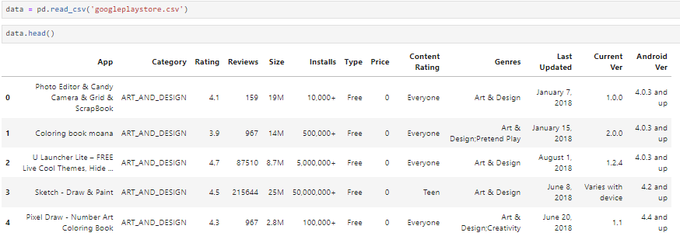
Dataset 1 - googleplaystore.csv
First 5 rows of the dataset

Slide 6
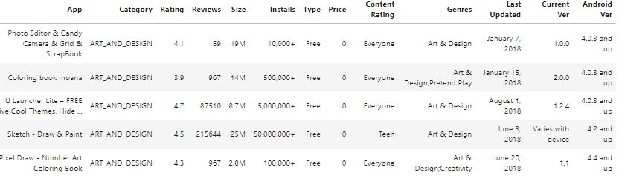
The analysis will be done based on the following features
Category
App
Rating
Installs
Reviews

Slide 7


EDA – Data Cleaning & Preprocessing
Find the size of the dataset
Remove special characters from Installs column and make it ‘int type’
Drop the rows with null values

Slide 8
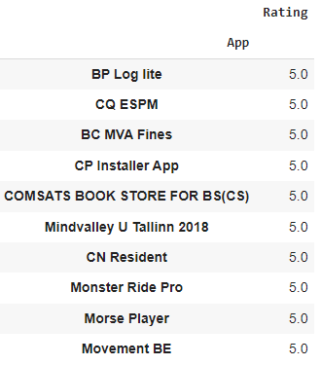

EDA
Table shows the 10 best rated apps on Google Play Store

Slide 9
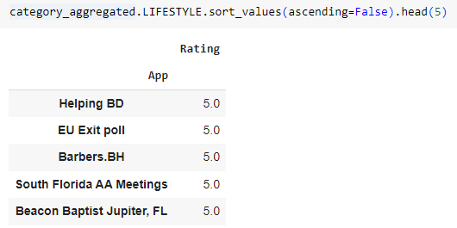
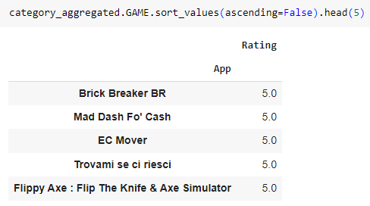
EDA
Table shows the 5 best rated apps on Google Play Store for individual category

Slide 10
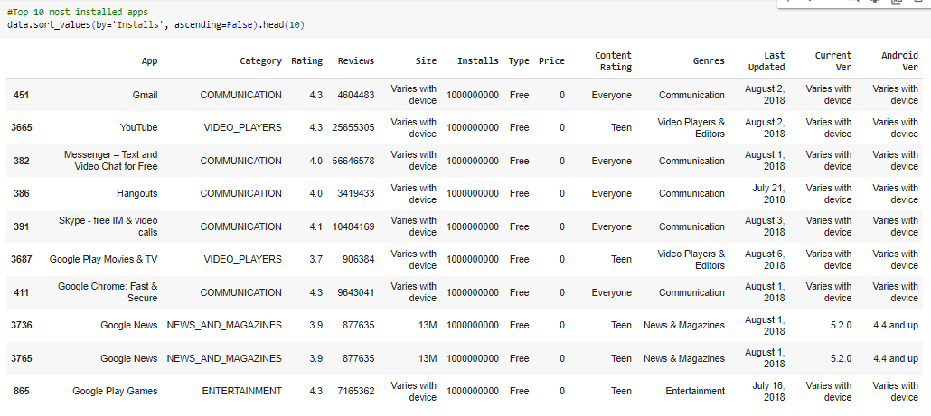
EDA
Top 10 most installed apps

Slide 11
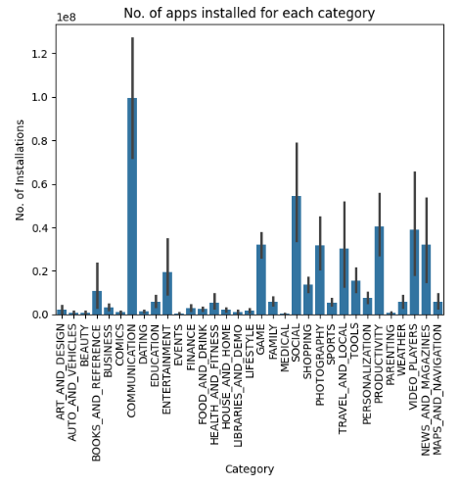

Data Visualization
Category vs Installs
INFERENCE
Maximum apps have been installed in ‘Communication’, ‘Social’ and ‘Video players’ category
Least apps have been installed for ‘Comics’, ‘Beauty’ and ‘Events’

Slide 12
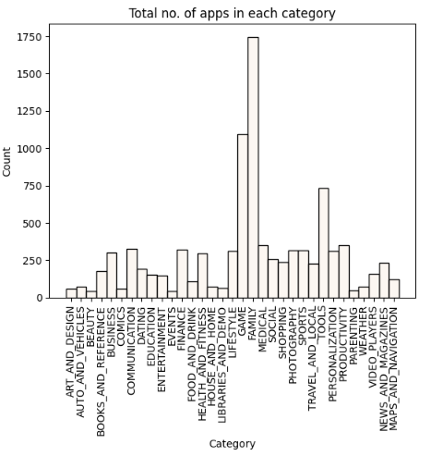

Data Visualization
No. of apps for each Category
INFERENCE
Maximum apps are available for ‘Family’, ‘Game’ and ‘Tools’ category
Very few apps are available for ‘Beauty’, ‘Events’ and ‘Parenting’

Slide 13
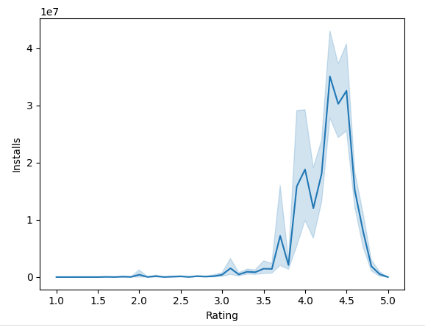

Data Visualization
Rating vs Installs
INFERENCE
The apps with rating between 4.0 and 4.5 have been installed the most

Slide 14
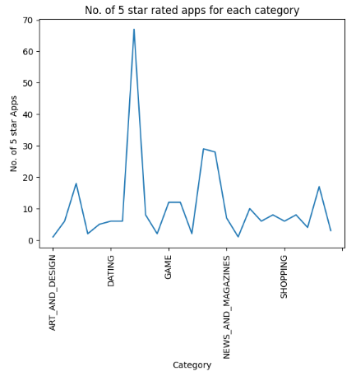
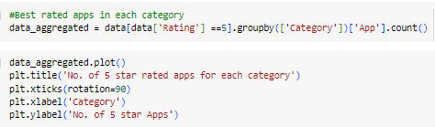
Data Visualization
Category vs Best Rated apps
INFERENCE
Maximum best rated apps are in Dating category

Slide 15
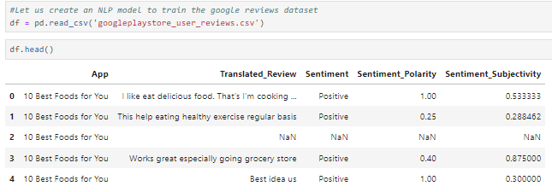
Dataset 2 - googleplaystore_user_reviews.csv
First 5 rows of the dataset

Slide 16
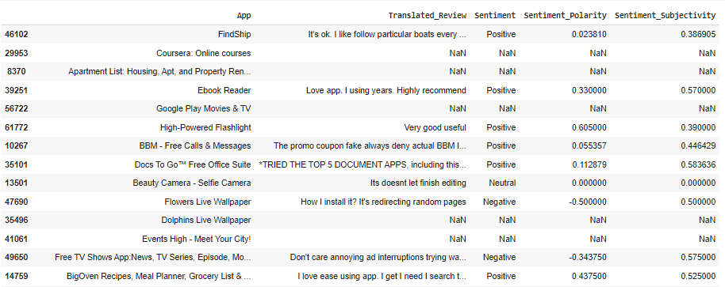
There are 5 columns in the dataset. For ‘Translated Review’ column, classification will be based on ‘sentiment’ column
X(Input feature) = Translated Review
Y(Output) = Sentiment

Slide 17


EDA – Data Cleaning & Preprocessing
Find the size of the dataset
Find unique Sentiments as it is a categorical feature
Drop the unwanted columns

Slide 18
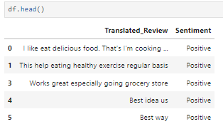
Dataset after cleaning

Slide 19
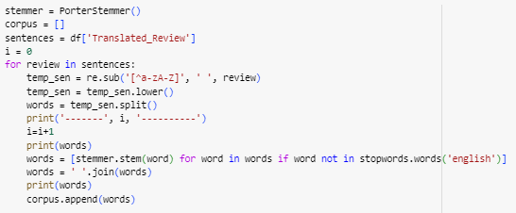
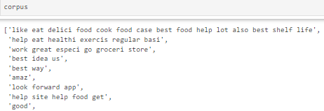
NLP – Data Preprocessing
Clean/Stem the ‘Translated_Review’ column and create a corpus
  Removed special characters and integers from the words
  Used PorterStemmer to stem the words
  Removed Stopwords in English
  Joined the words to create the corpus

Slide 20


NLP – Data Preprocessing
Encode the ‘Sentiment’ column values using LabelEncoder

Slide 21


Machine Learning Steps
Select X and Y
Convert words into vectors using TfidfVectorizer
Split X and Y into train and test data
NOTE: I will be training 2 machine learning models for the classification and calculating accuracy for both – Naïve Bayes and Random Forest Classifier

Slide 22



Machine Learning using Naïve Bayes
4. Train the data with Naïve Bayes – MultinomialNB model
5. Predict the values against test data
6. Calculate the accuracy score
Accuracy is 69.477%

Slide 23


Machine Learning using RandomForestClassifier
4. Train the data with RandomForestClassifier–
5. Predict the values against test data
6. Calculate the accuracy score
Accuracy is 88.521%

Slide 24
Conclusion
Random Forest Classifier performed better with Accuracy of 88.521% as compared to Naïve Bayes which gave an accuracy of 69.477%
INFERENCE
RandomForest is a better classifier for this dataset and can be used to classify more reviews into Positive or Negative

Slide 25
Thank You!
Shruti Gupta

